Slide 1
Sorting Algorithms
Insertion Sort

Slide 2
Insertion Sort
Insertion sort is almost as simple as selection sort but may be more flexible.
The method people often use to sort playing cards;
Consider the elements one at a time (from left -> right) inserting each in its proper place among those already considered (keeping them sorted).
The element being considered is inserted just by moving larger elements one position to the right, and then inserting the element in the empty position.
e.g. K♣ 5♥ 2♥ 9♦ 6♠
Hand as dealt
Sorted: 2♥ 5♥ 6♠ 9♦ K♣

Slide 3
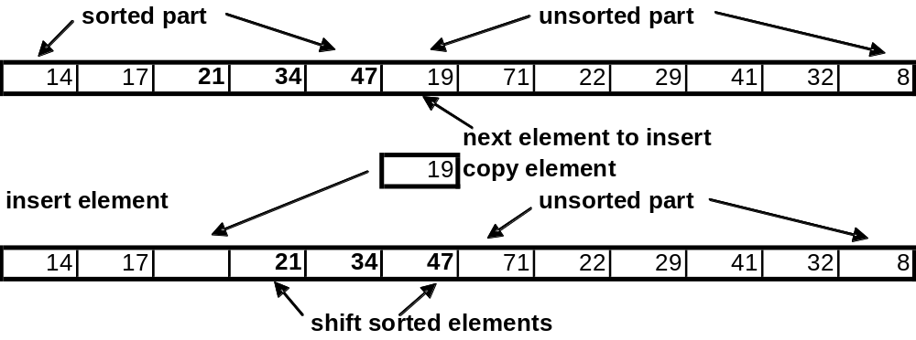
Insertion Sort
Insertion sort resembles the insertion function for a sorted list.
For a contiguous list, main costs are the comparisons to determine which part of the sorted list must be shifted, and the assignments needed to accomplish that shifting of the sorted tail.

Slide 4
InsertionSort Pseudocode
void insertionSort(int numbers[], int array_size)
{
int i, j, current;
for i = 1 , array_size – 1
{
current = numbers[i];
j = i;
while ((j > 0) && (numbers[j-1] > current))
numbers[j] = numbers[j-1]; // move element up 1 place
j = j - 1; // move to previous position
end while
numbers[j] = current; // copy element into free slot
}
}

Slide 5
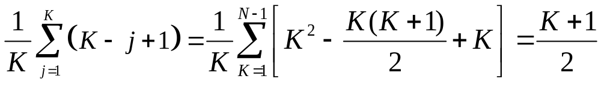
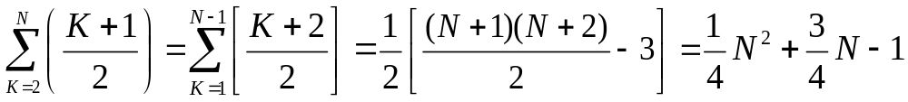
Insertion Sort comparisons
For a list of N elements, Insertion sort requires:
Average case: N²/4 + O(N) comparisons, and N²/4 + O(N) assignments.
Consider an element in position K, and suppose it ends up at position j, 1<= j <= K. This requires K – j +1 comparisons. So on average, number of comparisons to place the K^{th} element is:
The average total cost for insertion sort on list of N elements is:

Slide 6
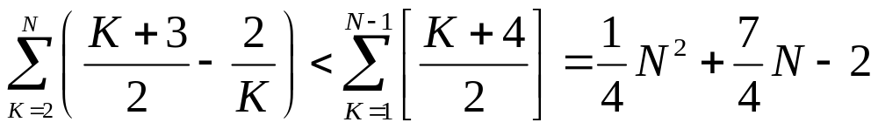
Insertion Sort assignments
Similar analysis for assignments. If element in K^{th} position ends up at position j, 1 <= j <= K-1, number of assignments is K – j + 2.
In special case where element does not move, no assignments take place.
As before, the average total no. of assignments satisfies:
Worst case: N²/2 + O(N) comparisons, and N²/2 + O(N) assignments
When does worst case occur?
Best case: N -1 comparisons, and no assignments. (already sorted)

Slide 7
Lower bound on Sorting complexity.
To improve on insertion sort, let us consider the question:
  How fast is it possible to sort?
By fast we mean, algorithmic complexity, not time. We consider the number of comparisons a sorting algorithm must make in order to fully sort a list.
We seek an answer of the form: any sorting algorithm, no matter how it works, must perform at least O(f(N)) comparisons when sorting a list of N elements.
Thus we cannot consider any particular sorting algorithm.

Slide 8
Permutations of N elements
From combinatorics (mathematics of counting)
Given a collection of N distinct objects the number of different ways to arrange them in a row is N!.
Thus, a sorting algorithm must, in the worst case, determine the correct ordering among N! possible results.
If the algorithm compares two elements, the result of the comparison eliminates certain orderings as the final answer, and directs the “search” to the remaining, possible orderings.
We may represent the process of comparison sorting with a binary tree…

Slide 9
Comparison Trees
A comparison tree is a binary tree in which each internal node represents the comparison of two particular elements of a set, and the edges represent the two possible outcomes of that comparison.
For example, given the set A = {a, b, c} a sorting algorithm will begin by comparing two of the elements (it doesn’t matter which two, so we’ll choose arbitrarily):
a < b TRUE
  a <= b <= c
  a <= c <= b
  c <= a <= b
a < b FALSE
  b <= a <= c
  b <= c <= a
  c <= b <= a

Slide 10
Comparison Trees
Theorem. Any algorithm that sorts a list of N entries by use of key comparisons must, in its worst case, perform at least log(N!) comparisons of keys, and, in the average case, it must perform at least log(N!) comparisons of keys.
Proof. The steps of the algorithm can be represented by a comparison tree. That tree must have N! leaves, since there are N! possible answers.
We proved earlier that the number of levels in a binary tree with N! leaves must have at least 1 +  log(N!) . If the answer corresponds to a leaf in the bottom level of the comparison tree, the algorithm must traverse at least  log(N!) internal nodes, and so must do at least  log(N!) comparisons.
This proves worst case lower bound.
The average case lower bound is similar.

Slide 11
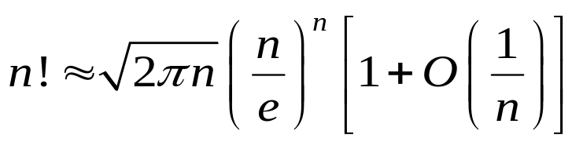
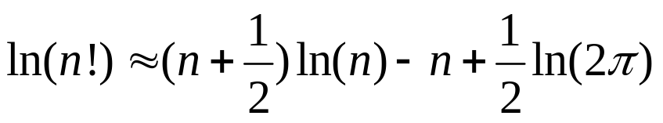
Stirling’s formula for N!
We can simplify above average lower bound formula using Stirling’s formula:
Taking the log (base e, i.e. ln(*) ) of both sides gives:
Using this formula and changing bases (to base 2) we have:
Rule change base. ln_{e}(x) = log₂(x) / log₂ (e)

Slide 12
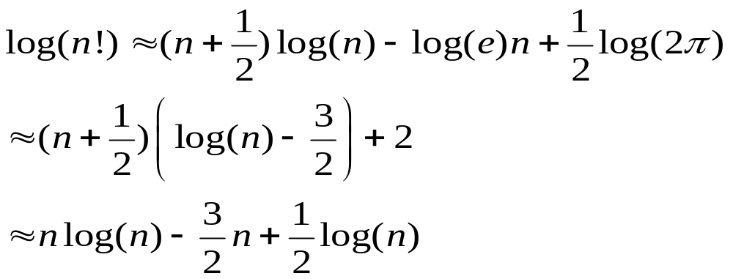
Stirling’s formula for N!
The 3/2 term above comes from log(e)  1.5
For reasonably large n, the first term dominates the others, so we have shown that the lower bound for comparisons in sorting is n log(n).
Simpler formula: (n/2)^{n/2} < n! < (n)^{n}.

Slide 13
Shell Sort
Shell Sort is a way to improve the insertion sort. It is named after
Donald Shell, (1959), and may be described as follows:
  partition the list into discontiguous sublists whose elements are some step size, h, apart.
  sort each sublist by applying Insertion Sort
  decrease the value of h and repeat the first two steps, stopping after a pass in which h is 1. (i.e. insertion sort)
The end result will be a sorted list because the final pass (with h being 1) is simply an application of Insertion Sort to the entire list.
What is an optimal sequence of values for the step size h? No one knows…

Slide 14
Shell Sort performance
What is the performance analysis for Shell Sort? It is not known… in general.
Knuth has shown that if two particular step sizes are used, then Shell Sort takes O(N^{3/2}) time (versus O(N²) for simple Insertion Sort).
Good mixing of the sublists can be provided by choosing the step sizes by the rule:
  h₁ = 1
  h_{i+1} = 3h_{i} + 1, for i >= 1
Empirically, for large values of N, Shell Sort appears to be about O(N^{5/4}) if the step size scheme given above is used.
Property 8.6. Sedgewick. Shellsort never does more than N^{3/2} comparisons (for the increments 1,4,13,40,121,….)

Slide 15
Divide and Conquer
Shellsort is a “divide and conquer” approach to solve problem.
We break a large problem into smaller parts (which are presumably more manageable), handle each part, and then recombine in some way the separate results to achieve a final solution.
In Shell Sort, the recombination is done by decreasing the step size to 1, and physically keeping the sublists within the original list structure.
Note that Shell Sort is better suited to a contiguous list than a linked list.
We will consider a similar algorithm that retains the “divide and conquer” strategy, but which is better suited to linked lists.

